Slide 1
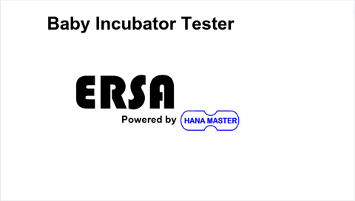

Slide 2
Baby Incubator Tester
Battery
%
Setup
Temperature Monitoring
Air Speed and Sound Level
Wiring Guide
Temperature Trend
Radiant Warmer
Placement Guide

Slide 3
Baby Incubator Tester
Battery
%
Setup
Temperature Monitoring
Air Speed and Sound Level
Wiring Guide
Temperature Trend
Radiant Warmer
Placement Guide

Slide 4



Baby Incubator Tester
Battery
83%
14/05/2024 10:45:32
Temperature .
26.4°C
26.4°C
Humidity .
Max Temp 1: 27.2°C
Max Temp 4: 27.2°C
26.4°C
26.4°C
45.2%
Max Temp 2: 27.2°C
Max Temp 5: 27.2°C
26.4°C
26.4°C
Max Temp 3: 27.2°C
Max Temp 6: 27.2°C

Slide 5

Baby Incubator Tester
Battery
%
14/05/2024 10:45:32
Temperature .
26.4°C
26.4°C
Humidity .
Max Temp 1: 27.2°C
Max Temp 4: 27.2°C
26.4°C
26.4°C
56.2
Max Temp 2: 27.2°C
Max Temp 5: 27.2°C
26.4°C
26.4°C
Max Temp 3: 27.2°C
Max Temp 6: 27.2°C

Slide 6
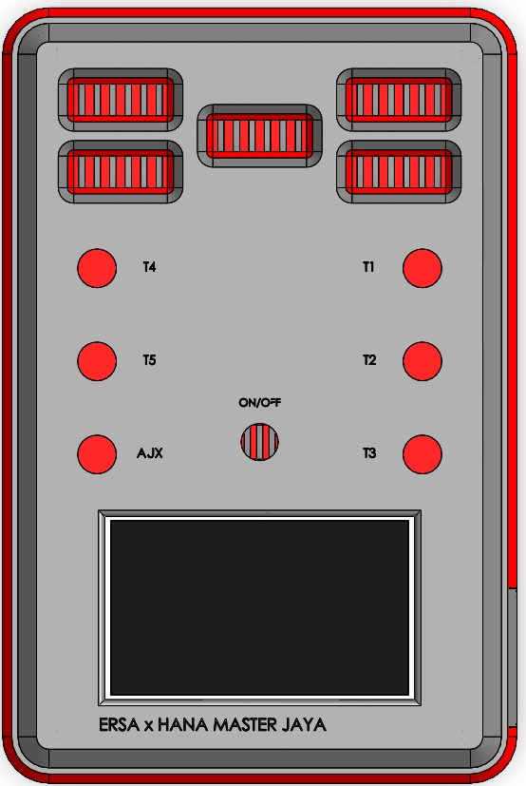
Baby Incubator Tester
Battery
%
Placement Guide
T4
T1
T5
T2
AJX
T3
T1 – T5 = Temperature Sensors
AJX = Air speed and sound level
DC 12V In

Slide 7
Baby Incubator Tester
Battery
%
Placement Guide
T4
T1
T5
T2
AJX
T3
T1 – T5 = Temperature Sensors
AJX = Air speed and sound level
DC 12V In

Slide 8
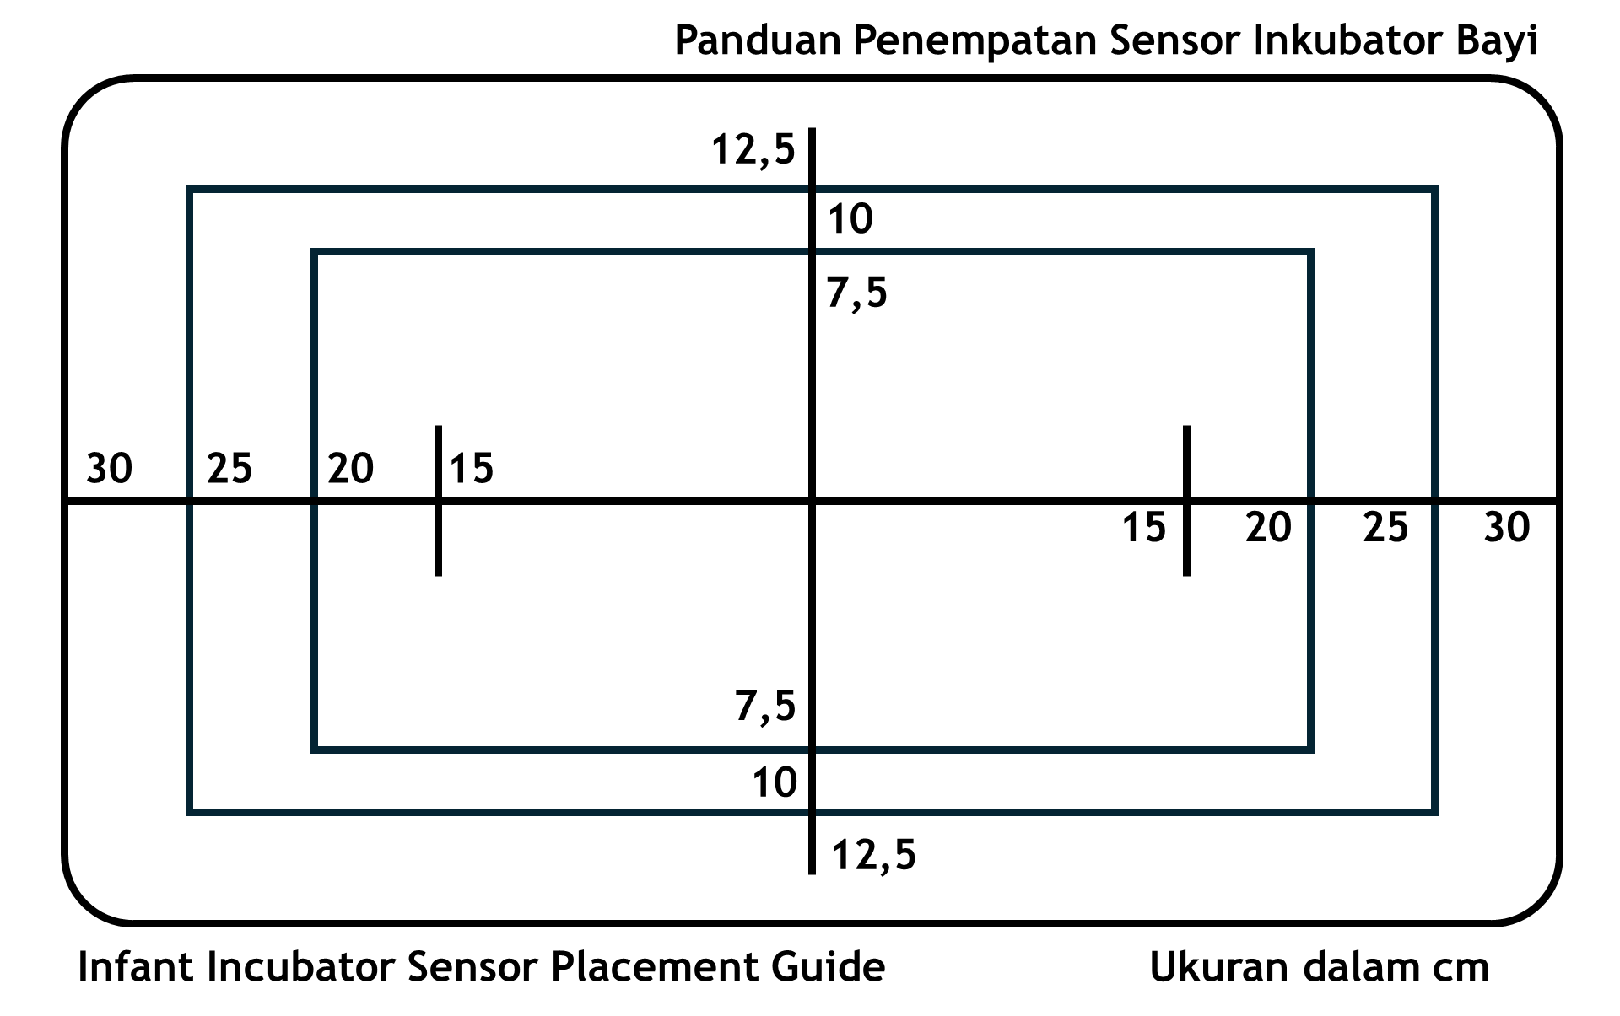
Baby Incubator Tester
Battery
%
Wiring Guide

Slide 9
Baby Incubator Tester
Battery
%
Wiring Guide

Slide 10




Baby Incubator Tester
Battery
%
Air Speed
Sound Level
m/s
dB

Slide 11


Baby Incubator Tester
Battery
%
RADIANT WARMER MODE
Please connect Thermal Absorber sensor to T6!
Disk Temp
Max Temp
$$°\text{C}$$
$$°\text{C}$$

Slide 12






TEMPERATURE TREND
Real-Time
T1
T2
T3
T4
T5
T6
$$°\text{C}$$
$$°\text{C}$$
$$°\text{C}$$
$$°\text{C}$$
$$°\text{C}$$
$$°\text{C}$$
Clear
Pause
Resolution
1s
2s
4s
8s

Slide 13
TEMPERATURE TREND
Real-Time
T1
T2
T3
T4
T5
T6
$$°\text{C}$$
$$°\text{C}$$
$$°\text{C}$$
$$°\text{C}$$
$$°\text{C}$$
$$°\text{C}$$
Clear
Pause
Resolution
1s
2s
4s
8s

Slide 14
TEMPERATURE TREND
Real-Time
T1
T2
T3
T4
T5
T6
$$°\text{C}$$
$$°\text{C}$$
$$°\text{C}$$
$$°\text{C}$$
$$°\text{C}$$
$$°\text{C}$$
Clear
Resume
Resolution
1s
2s
4s
8s

Slide 15
TEMPERATURE TREND
Real-Time
T1
T2
T3
T4
T5
T6
$$°\text{C}$$
$$°\text{C}$$
$$°\text{C}$$
$$°\text{C}$$
$$°\text{C}$$
$$°\text{C}$$
Clear
Resume
Resolution
1s
2s
4s
8s

Slide 16
Temperature trend will be cleared.
No data saved. Are you sure?
Yes
No

Slide 17
Temperature trend will be cleared.
No data saved. Are you sure?
Yes
No

Slide 18
Baby Incubator Tester
Battery
%
BRIGHTNESS
%
DATE AND TIME SETTINGS
/ /
Change
: :

Slide 19
Baby Incubator Tester
Battery
%
BRIGHTNESS
%
DATE AND TIME SETTINGS
/ /
<
>
Set
: :
+
-

Slide 20
Baby Incubator Tester
Battery
%
BRIGHTNESS
%
DATE AND TIME SETTINGS
/ /
<
>
Set
: :
+
-

Slide 21
Panduan Penempatan Sensor Inkubator Bayi
12,5
10
7,5
30
25
20
15
15
20
25
30
7,5
10
12,5
Infant Incubator Sensor Placement Guide
Ukuran dalam cm

Slide 22
Baby Incubator Tester
Battery
%
Data Stream Only
Data Capture and Stream

Slide 23
Baby Incubator Tester
Battery
%
Data Stream Only
Data Capture and Stream

Slide 24
Baby Incubator Tester
Battery
%
File Name
Back
Save

Slide 25
Baby Incubator Tester
Battery
%
File Name
Back
Save

Slide 26
Baby Incubator Tester
Battery
%
File Name
File created!
Back
Save

Slide 27
TEMPERATURE TREND
Real-Time
T1
T2
T3
T4
T5
T6
$$°\text{C}$$
$$°\text{C}$$
$$°\text{C}$$
$$°\text{C}$$
$$°\text{C}$$
$$°\text{C}$$
Clear
Pause
Start Capture
Res
1s
2s
4s
8s

Slide 28
TEMPERATURE TREND
Real-Time
T1
T2
T3
T4
T5
T6
$$°\text{C}$$
$$°\text{C}$$
$$°\text{C}$$
$$°\text{C}$$
$$°\text{C}$$
$$°\text{C}$$
Clear
Pause
Start Capture
Res
1s
2s
4s
8s

Slide 29
TEMPERATURE TREND
Writing to
Real-Time
T1
T2
T3
T4
T5
T6
$$°\text{C}$$
$$°\text{C}$$
$$°\text{C}$$
$$°\text{C}$$
$$°\text{C}$$
$$°\text{C}$$
Clear
Resume
Stop and Save
Res
1s
2s
4s
8s

Slide 30
TEMPERATURE TREND
Real-Time
T1
T2
T3
T4
T5
T6
$$°\text{C}$$
$$°\text{C}$$
$$°\text{C}$$
$$°\text{C}$$
$$°\text{C}$$
$$°\text{C}$$
Clear
Resume
Stop and Save
Res
1s
2s
4s
8s

